Slide 1
EE150 Signals and Systems Tutorial 2
Guorui Cui
Shanghaitech University
Mar. 13. 2024

Slide 2
Properties of System
LTI System
Discrete-time Convolution

Slide 3
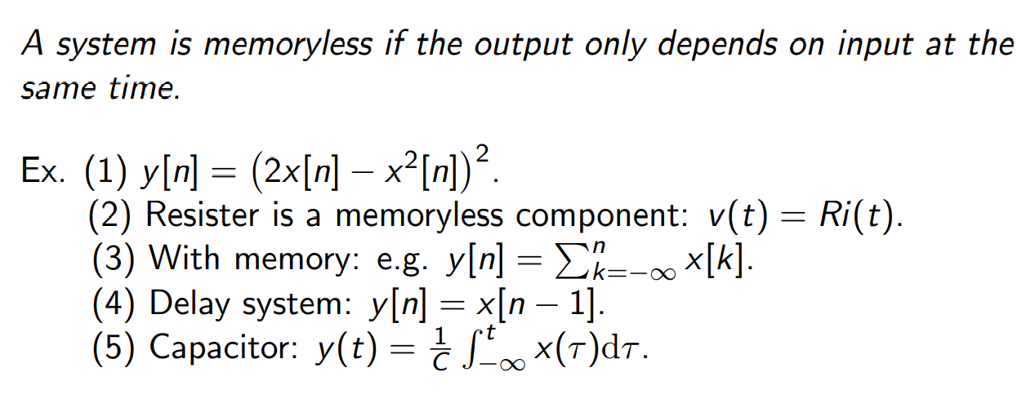
Memory/Memoryless
Notes:
A system is said to be memoryless if the output at any time depends on only the input at that same time. Otherwise, the system is said to have memory.
TTFFF

Slide 4
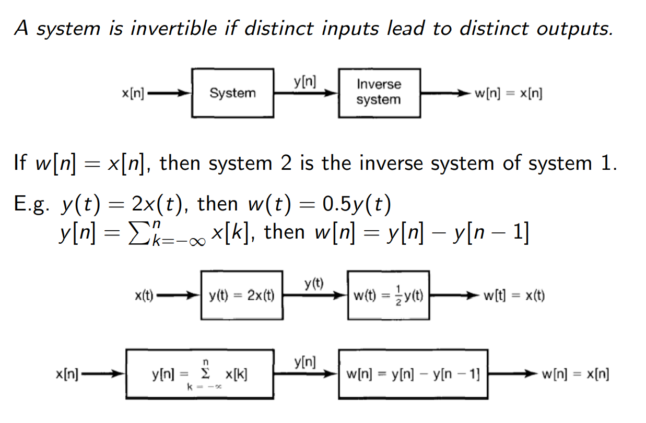
Invertibility and Inverse System
Notes:
可逆

Slide 5
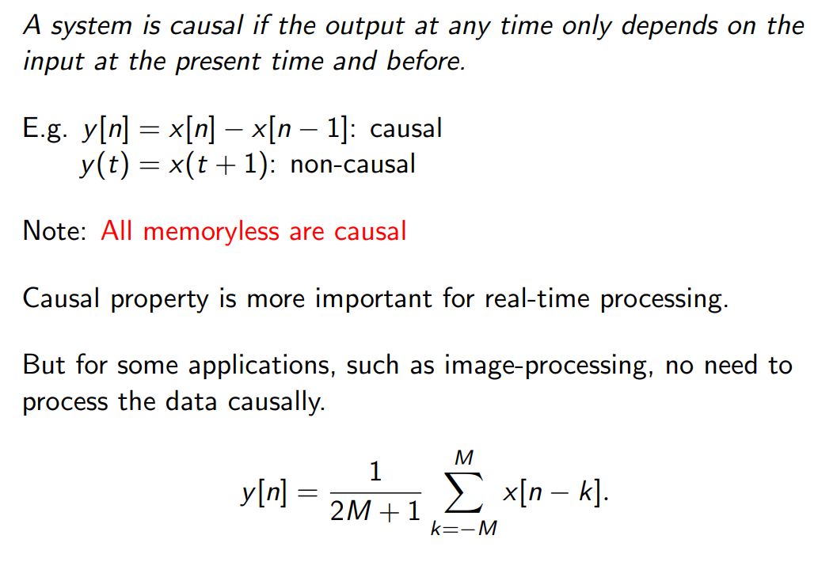
Causality

Slide 6
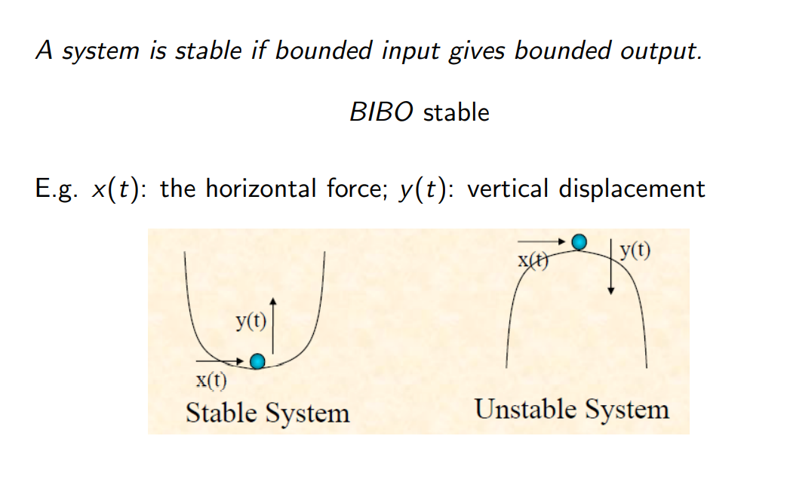
Stability
Notes:
bounded-input bounded-output (BIBO) stable

Slide 7
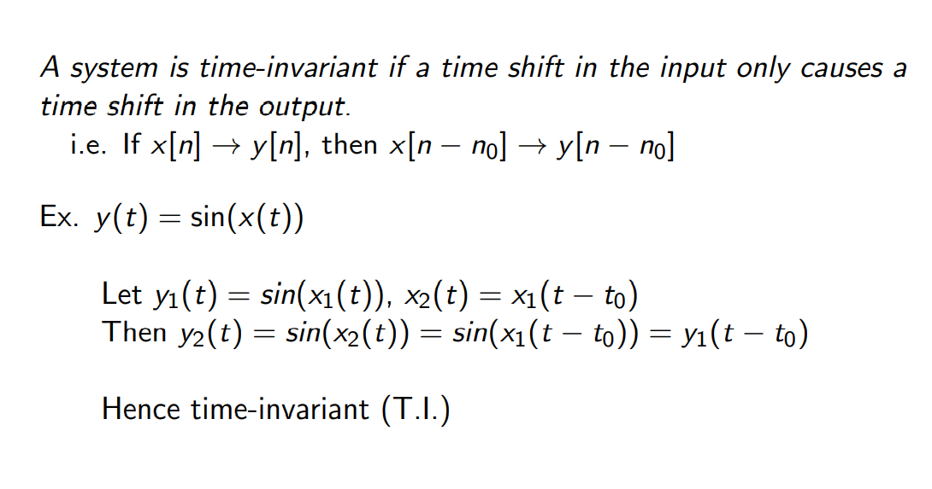
Time-invariance

Slide 8
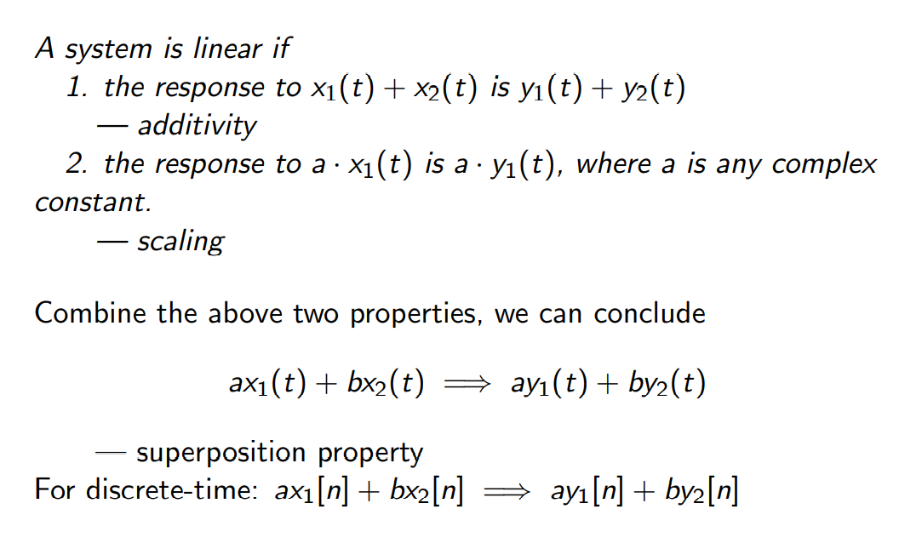
Linearity

Slide 9
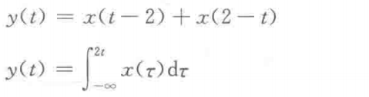
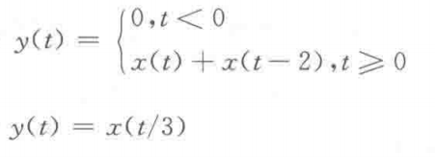

Exercise
Memoryless? Time-invariant? Linear? Causal? Stable?

Slide 10
Answer
1. Memory; Time-variant; Linear; Non-causal; Stable
2. Memory; Time-variant; Linear; Non-causal; Unstable
3. Memory; Time-variant; Linear; Causal; Stable
4. Memory; Time-variant; Linear; Non-causal; Stable
5.Memory; Time-invariant; Linear; Non-causal; Unstable

Slide 11
Properties of System
LTI System
Discrete-time Convolution

Slide 12
Why LTI is Important?
First, many physical processes possess the properties of linearity and time invariance;
Second, if we can represent any input by a summation of basic signal (δ(t) or δ[n]) and its time-shifted version, then by using LTI property, the output can be found from the summation or integration of the individual output of the system in terms of its reponses to basic signal and its time-shifted version.

Slide 13
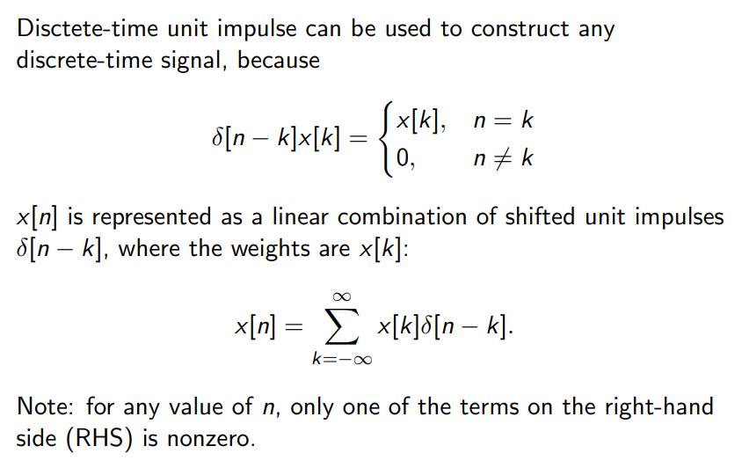
Representation of Discrete-Time Signals

Slide 14
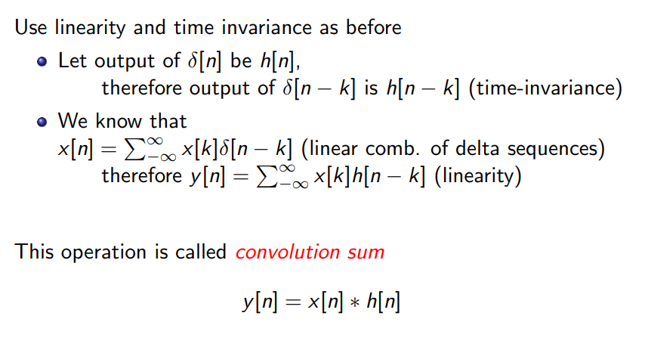
Compute output of LTI system

Slide 15
Properties of System
LTI System
Discrete-time Convolution

Slide 16
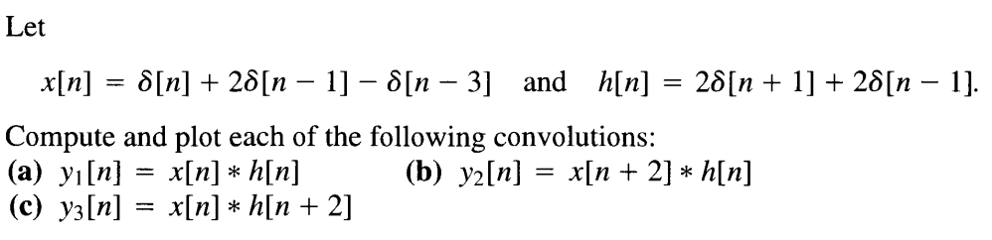
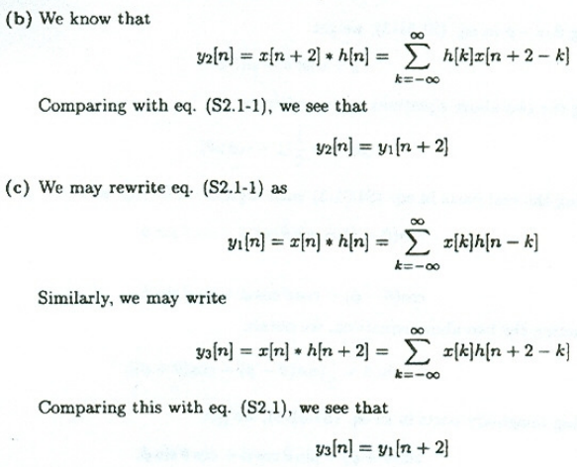
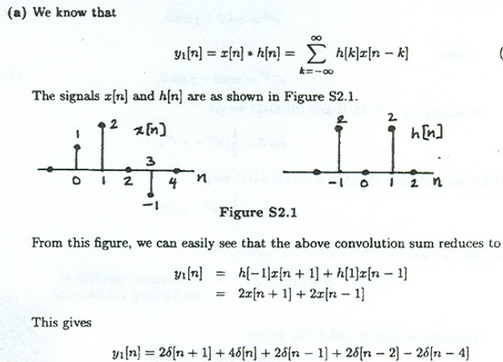
Compute Discrete-time Convolution

Slide 17
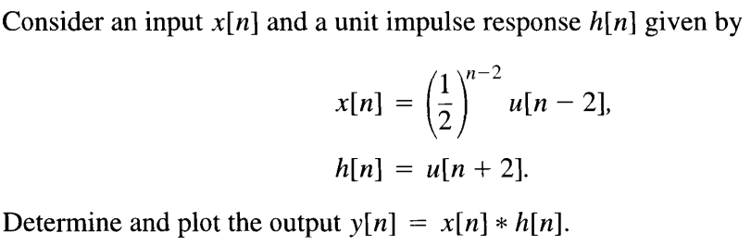
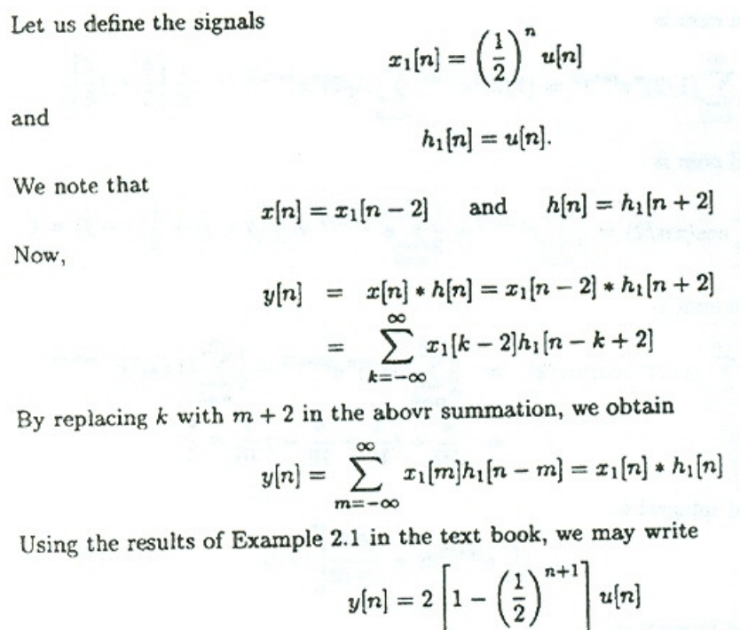
Compute Discrete-time Convolution

